Slide 1

Together
— HCI COURSE REPORT
Wang Jiaqi
Sun Shichen
Nie Yao
Zhuang Zhenhua
Liu Ziyun

Slide 2
Background
Tasks
CONTENTS
UI design
UI change and evaluation
Final interface

Slide 3
BACKGROUND
----Liu Ziyun

Slide 4

Background
Problem
You might feel lonely when you run, study, and entertain by yourself.
There is no suitable app that allows us to find people with common interests
Solution Overview
In order to solve the above problems, we designed a mobile app, through which users can publish a team activity or join an activity, so that people with the same interests and hobbies can study or play together.
Target User Group
The target users of the app are teachers and students in Tongji.

Slide 5
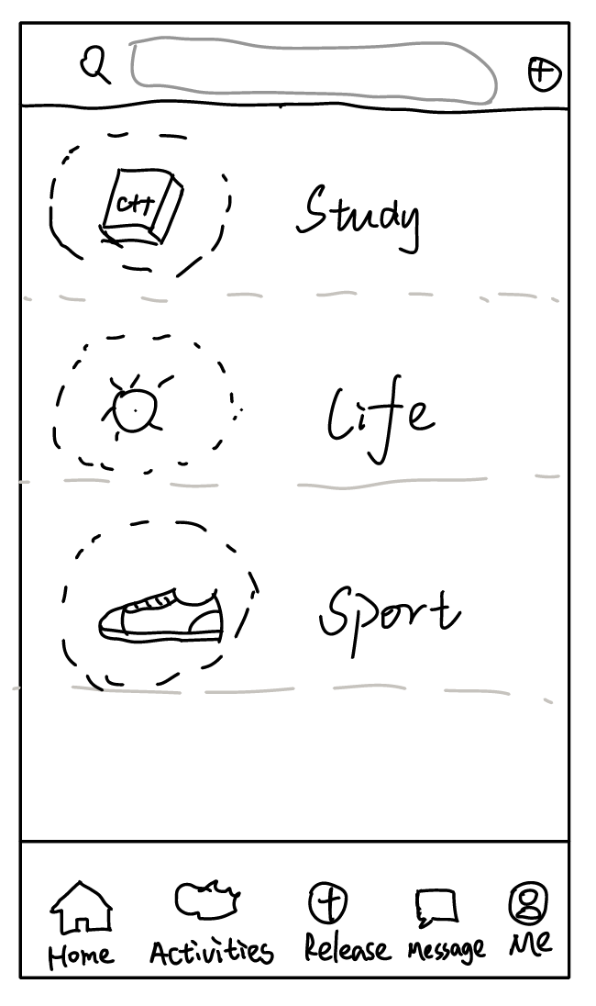
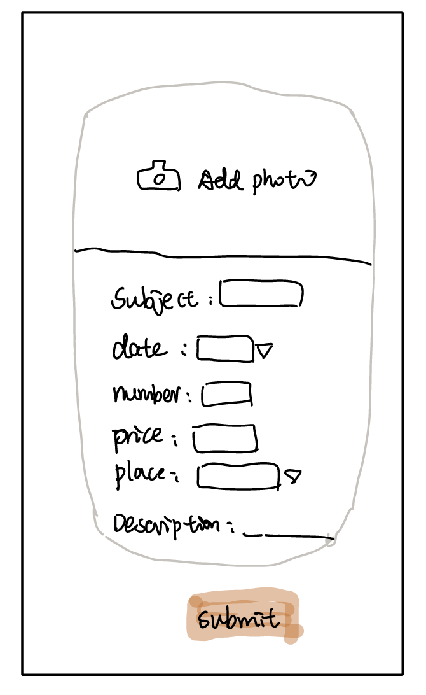
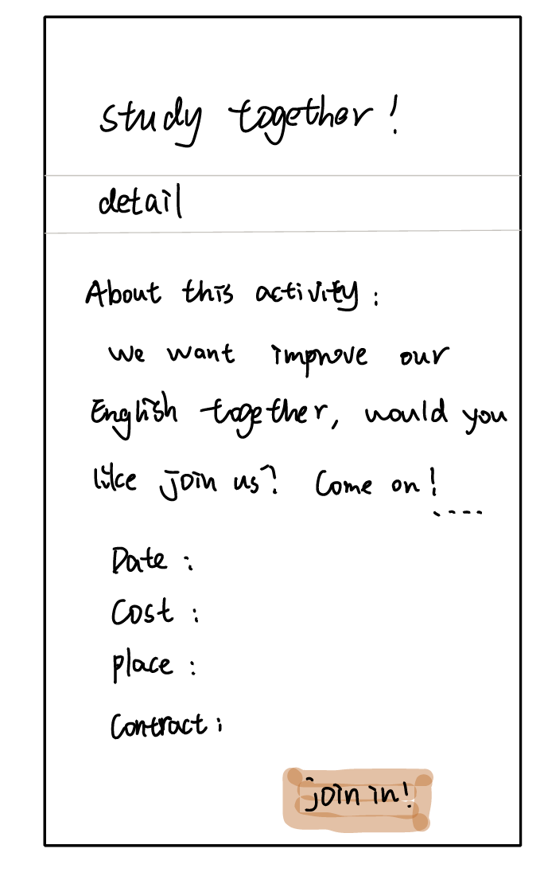
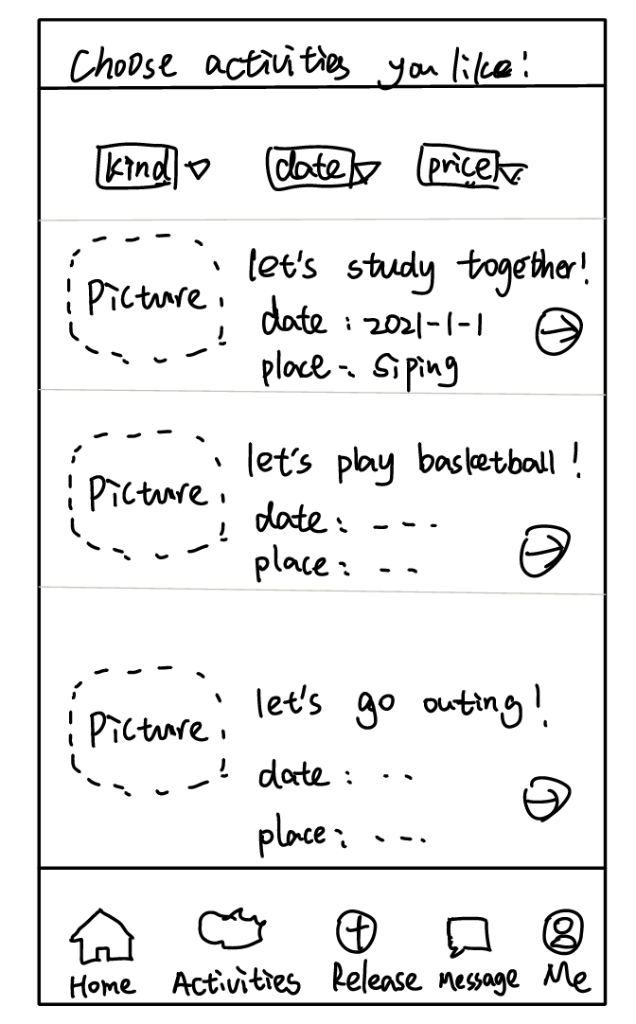
Draft
Release Page &
Description of a release
Activities Page &
Description of an activity

Slide 6
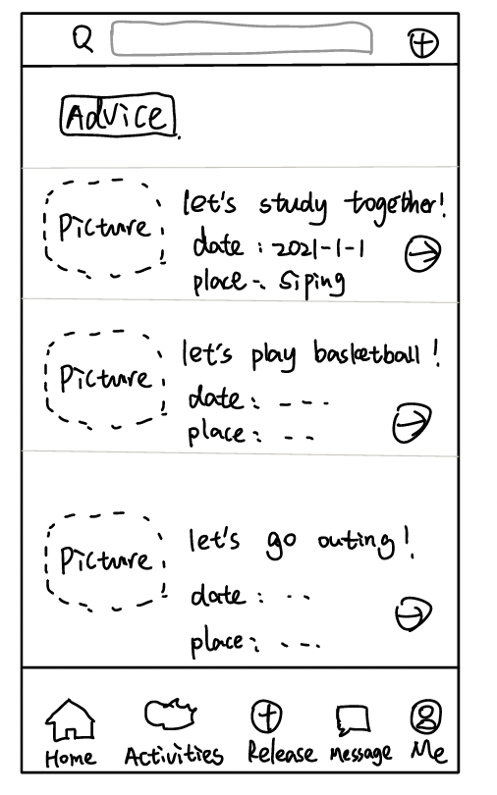
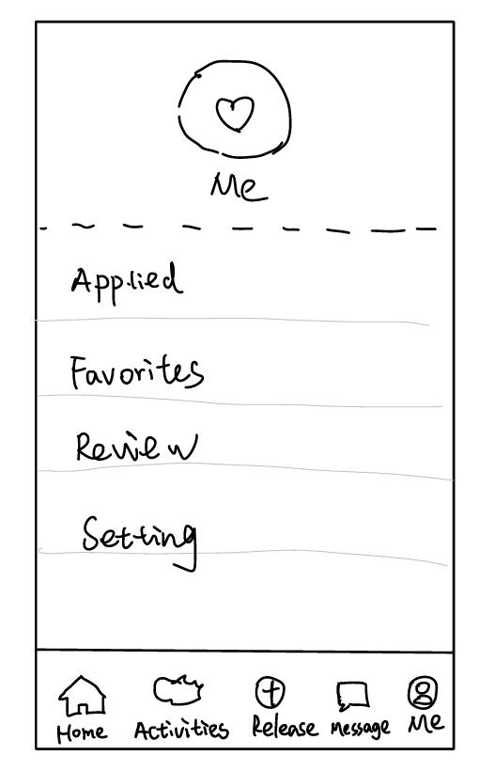
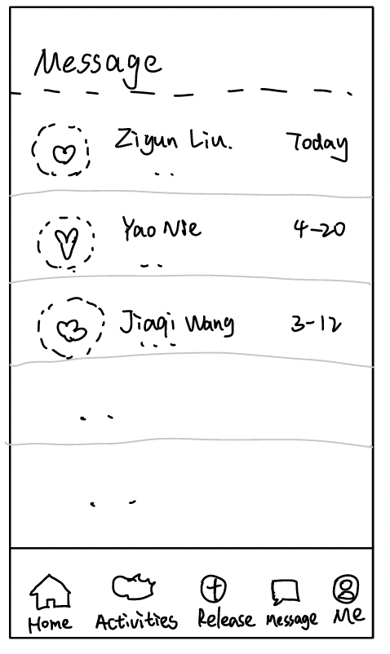
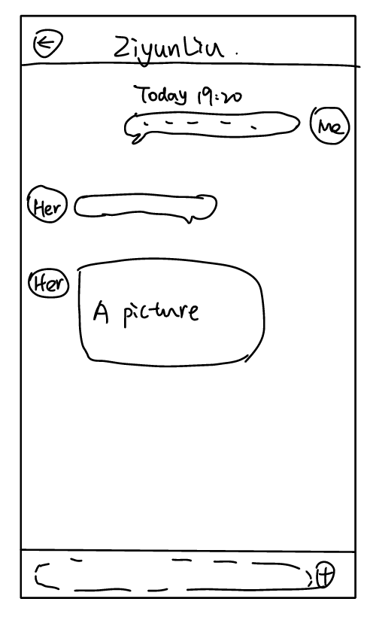
Draft
Home Page &
Me Page
Message Page &
Contact Page

Slide 7
TASK

Slide 8

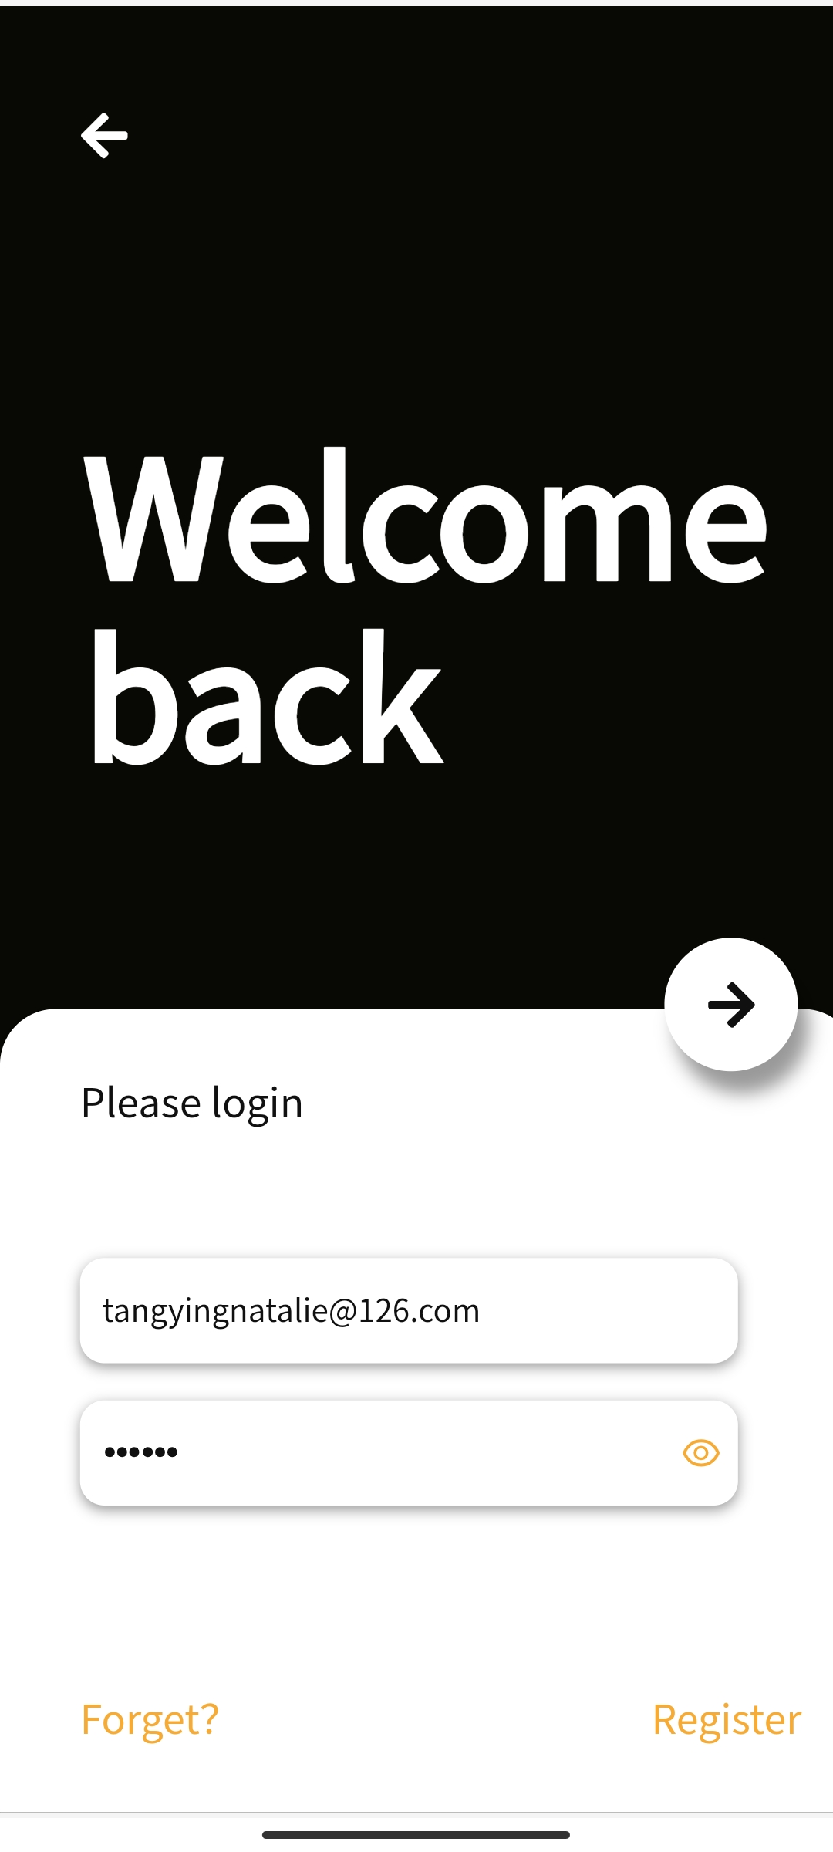
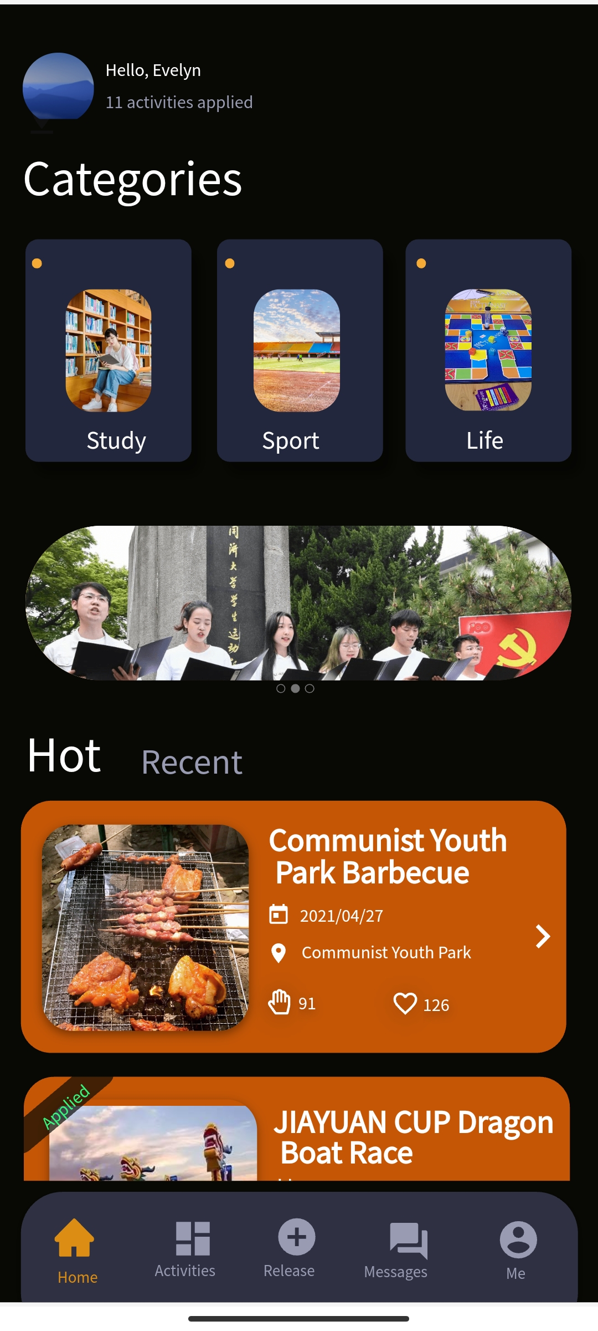
Task-easy
Display Page
Login Page
Home Page

Slide 9
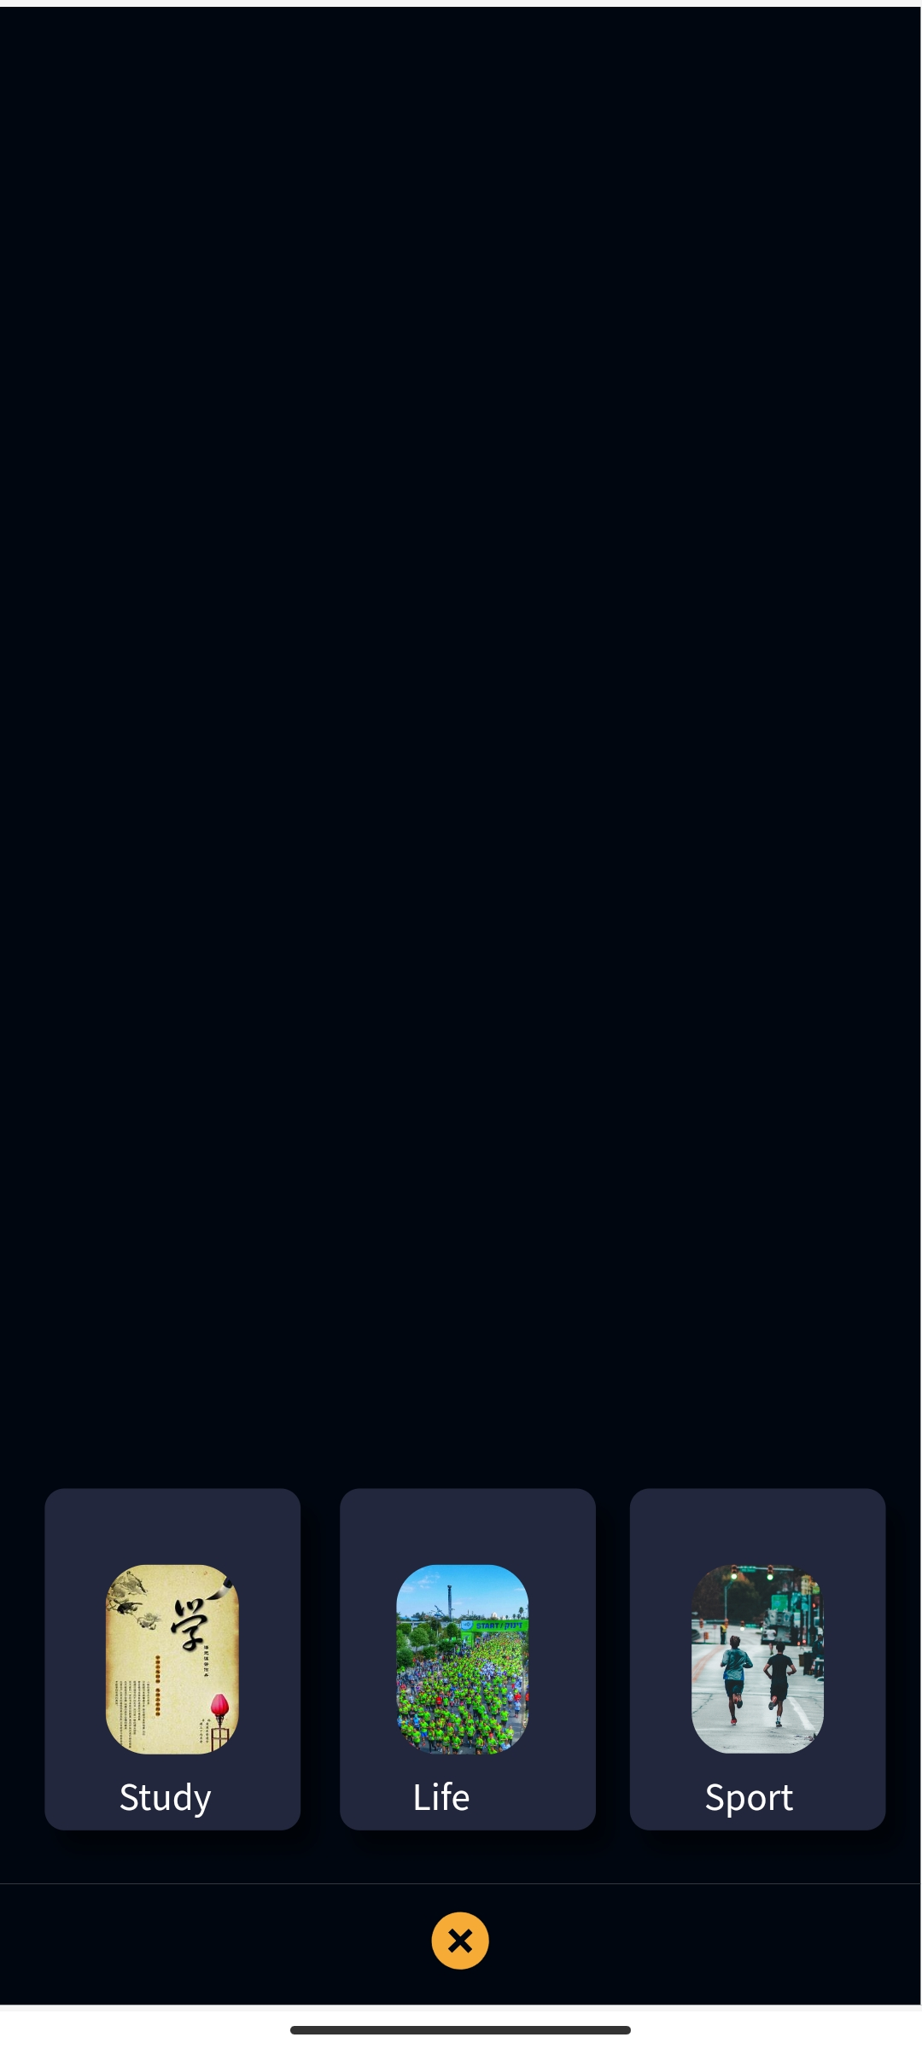
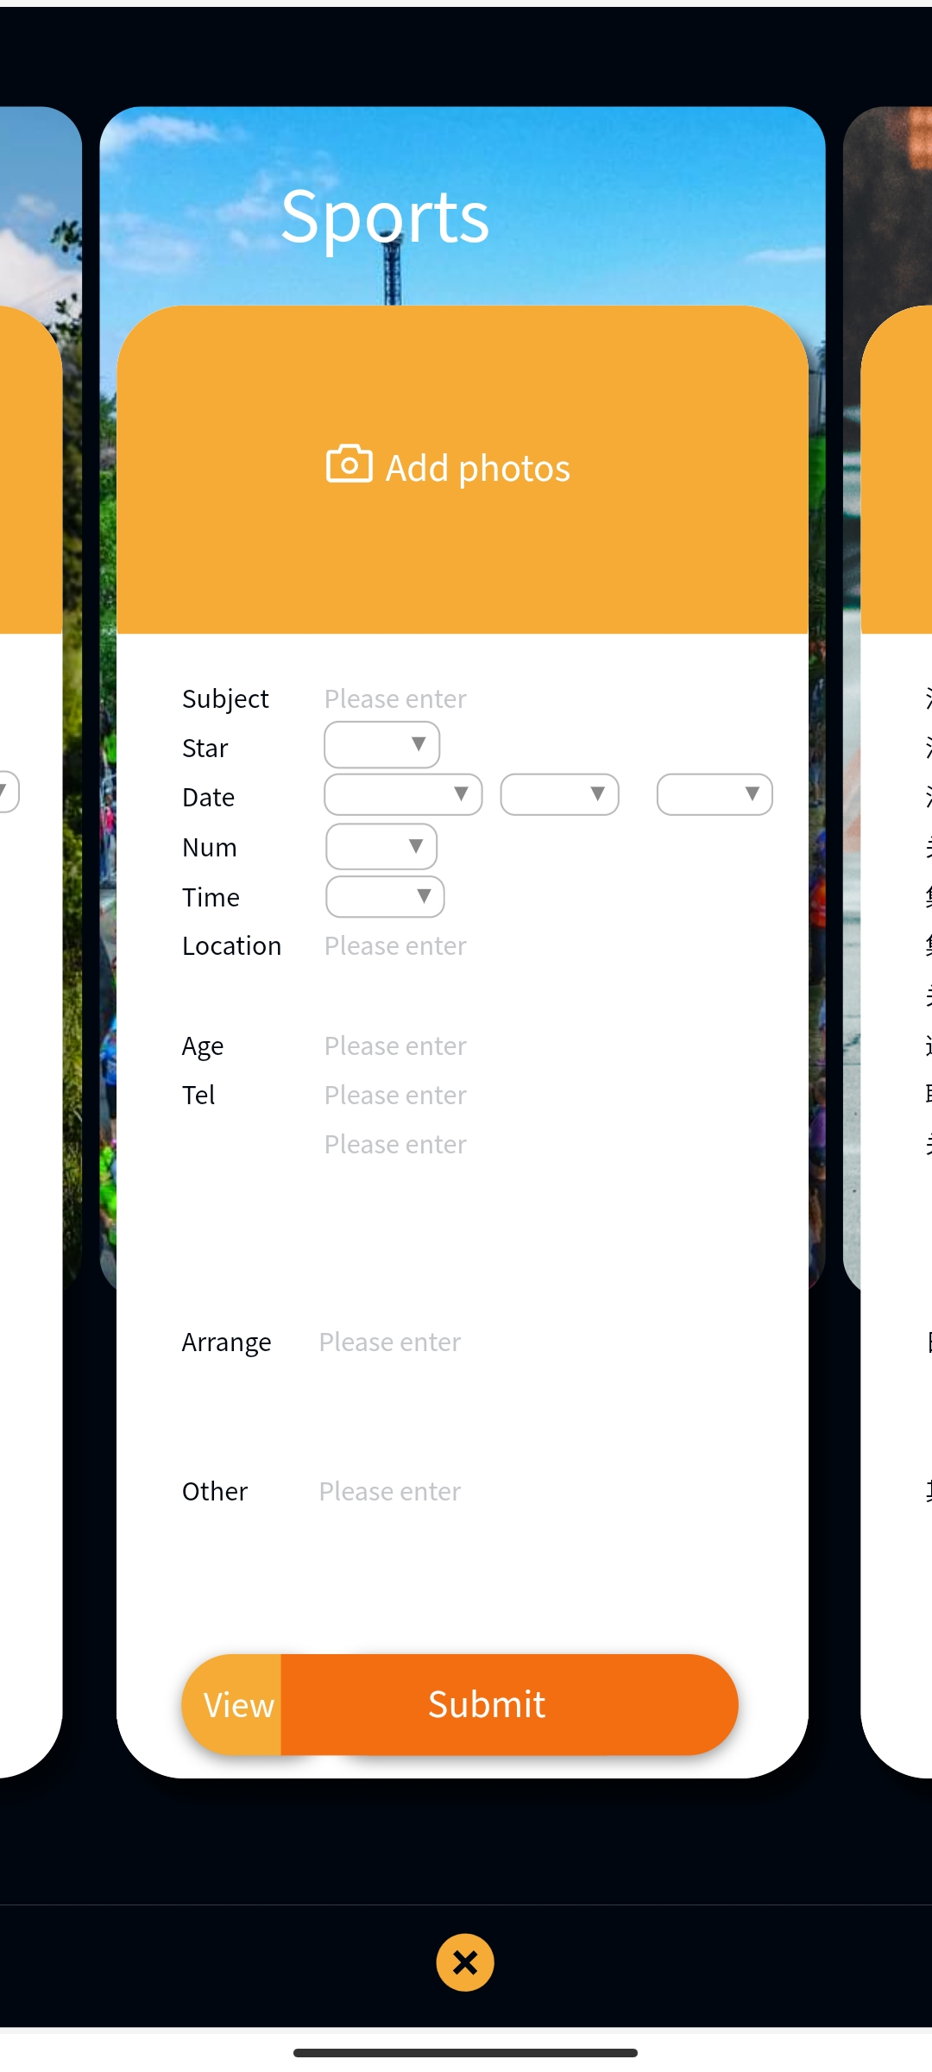
Task-medium
Release Page
Release an activity

Slide 10
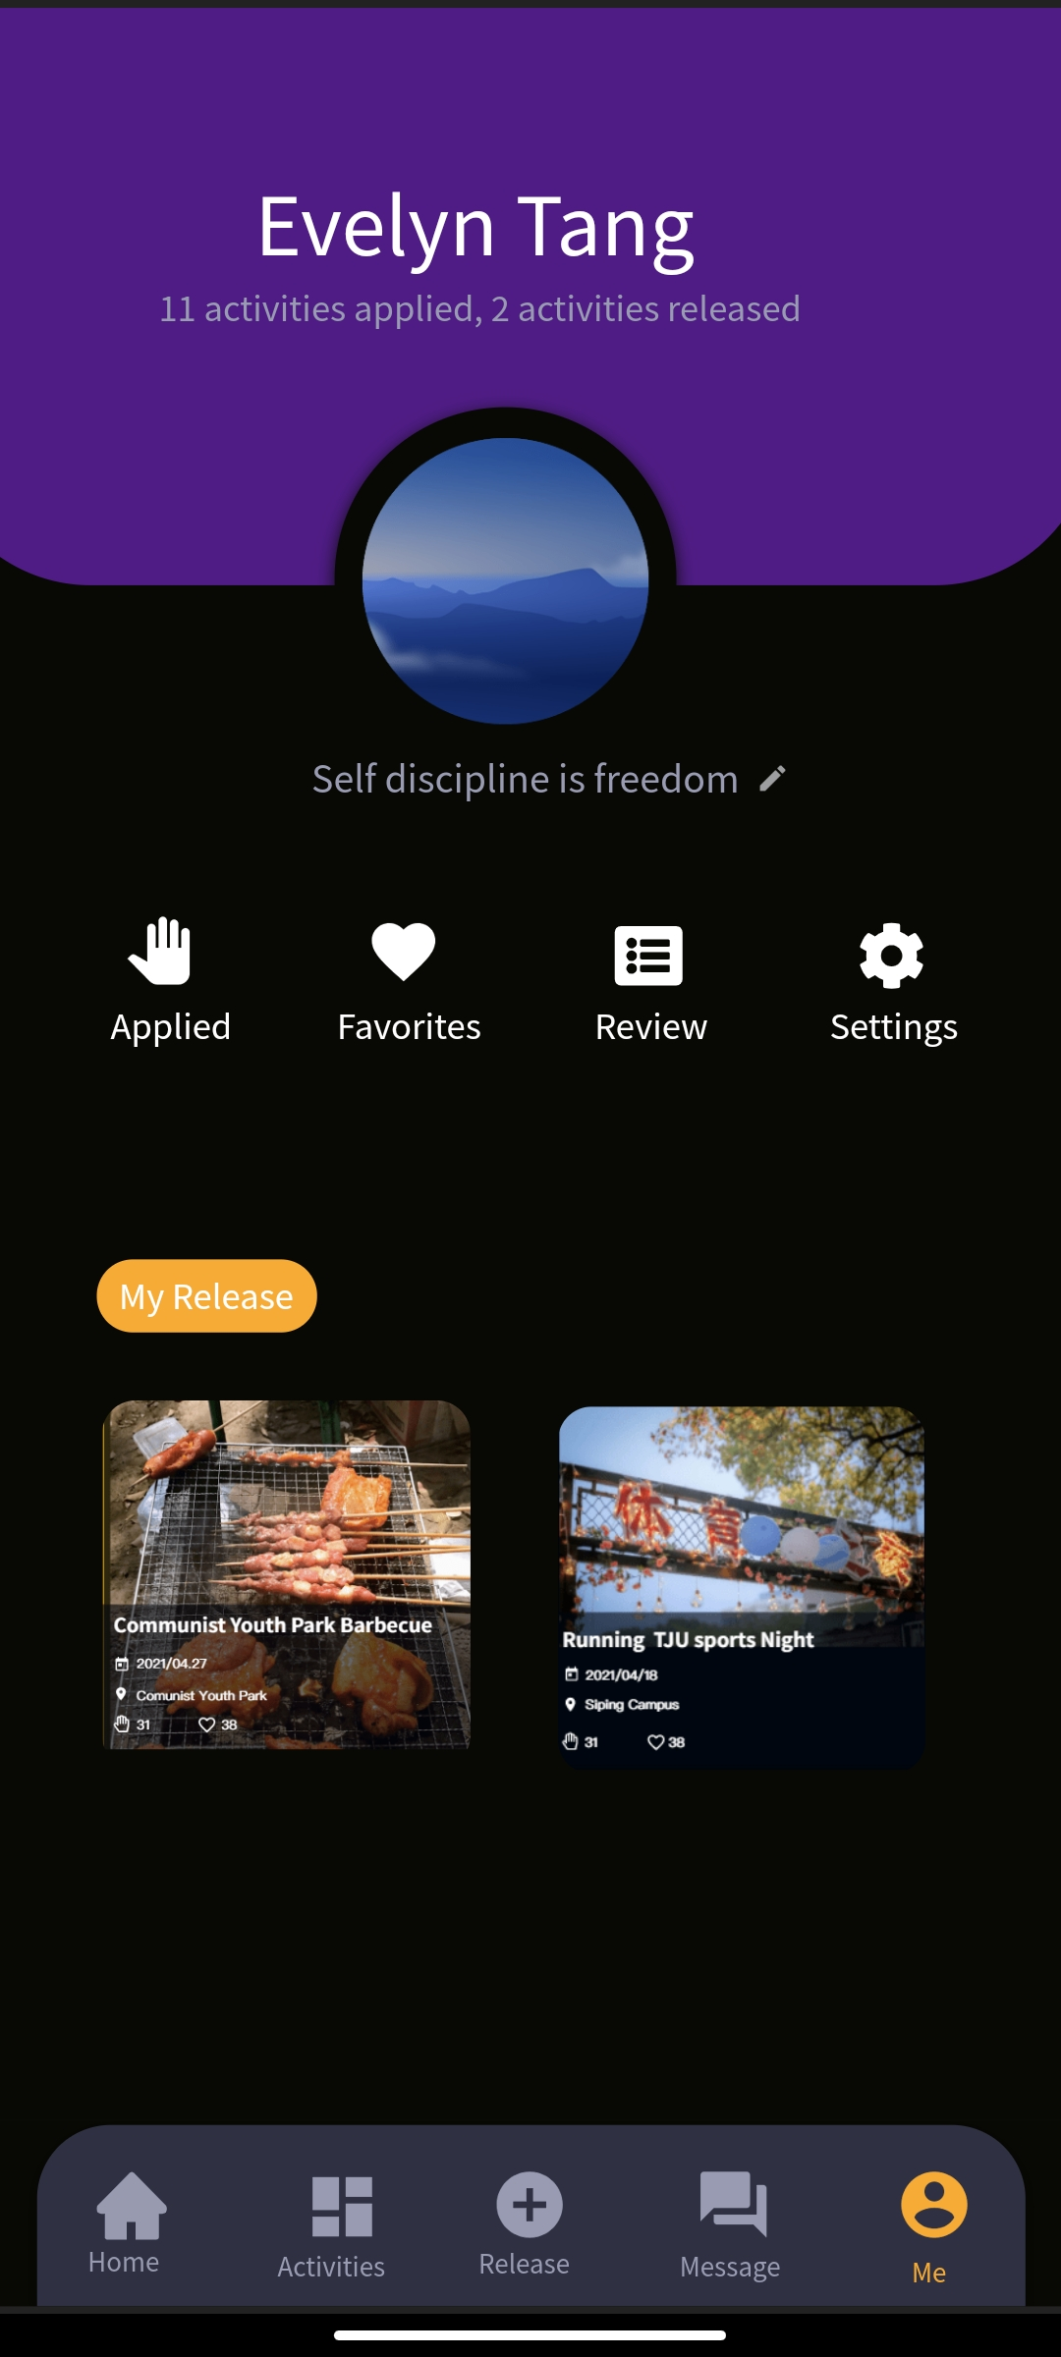
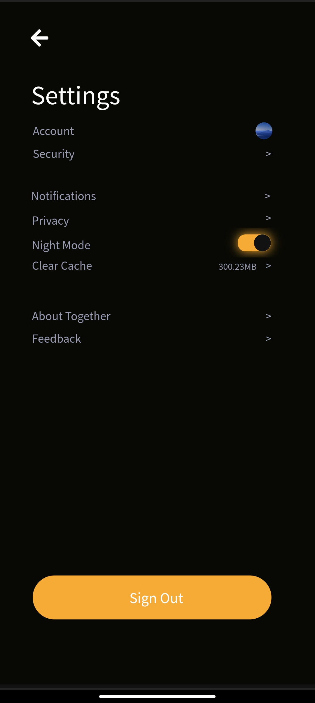
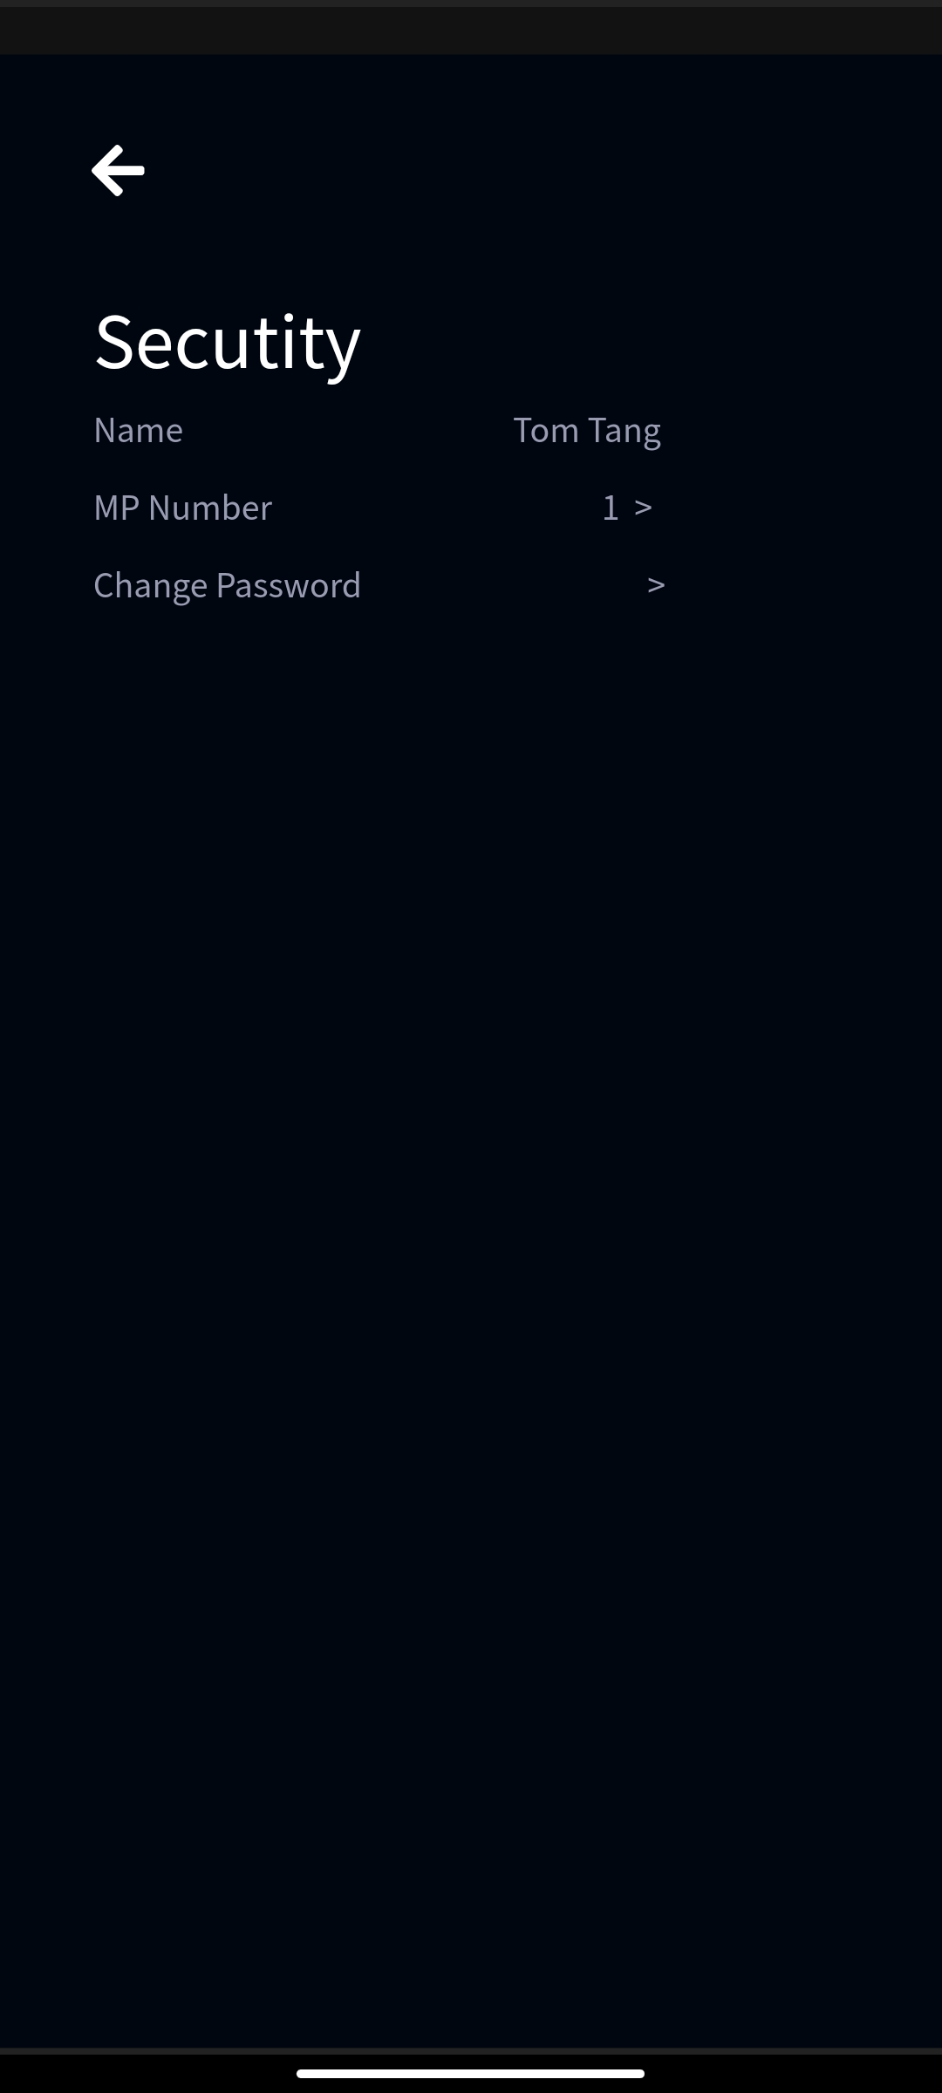
Task-hard
Me Page
Settings Page
Security Page

Slide 11
UI-DESIGN
----Wang Jiaqi

Slide 12
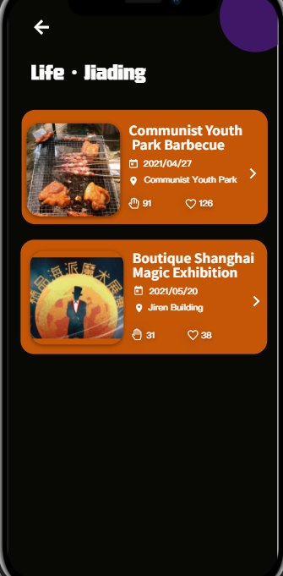
UI-Colors
Principle: the 60% + 30% + 10% rule
60% : the main color,
30% : the secondary color
10% : the accent color
It works by creating a sense of balance and allowing the eye to comfortably transition from one focus to the next.
Other rules:
1. Colors used in display should be as distinct as possible and the distinction should not be affected by changes in contrast.
2. Negative contrast improves reading performance (white characters on blackscreen).
Why Orange:
Eye-catching color
Dynamic, open and bright psychological feeling
User will be more motivated

Slide 13
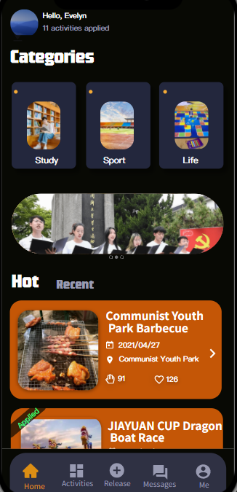
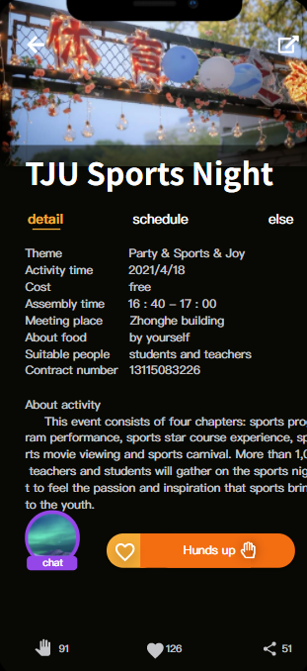
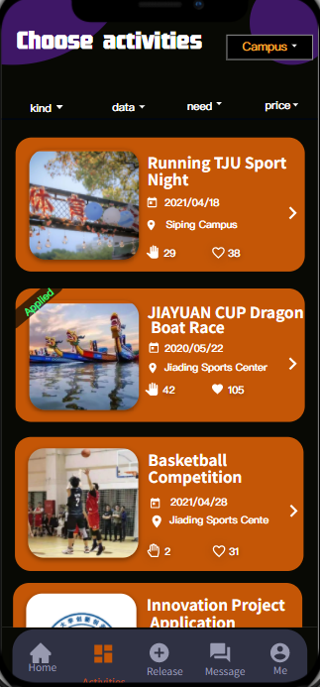
UI-Design
Strive for consistency in action sequences, layout, terminology, command use and so on.
---Shneiderman's eight golden rules

Slide 14
UI-Design
Enable frequent users to use shortcuts, such as abbreviations, special key sequences and macros, to perform regular, familiar actions more quickly.
---Shneiderman's eight golden rules

Slide 15
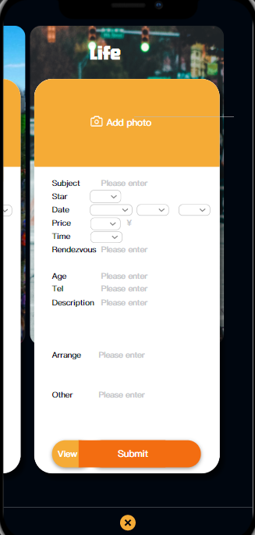
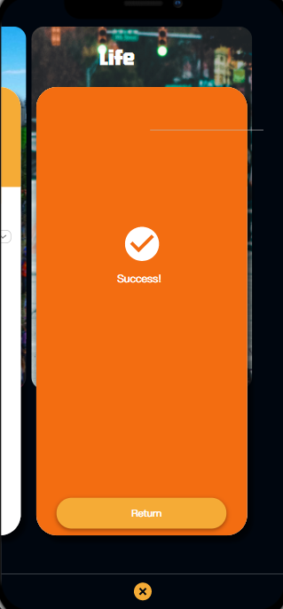
UI-Design
Design dialogs to yield closure so that the user knows when they have completed a task.
---Shneiderman's eight golden rules

Slide 16
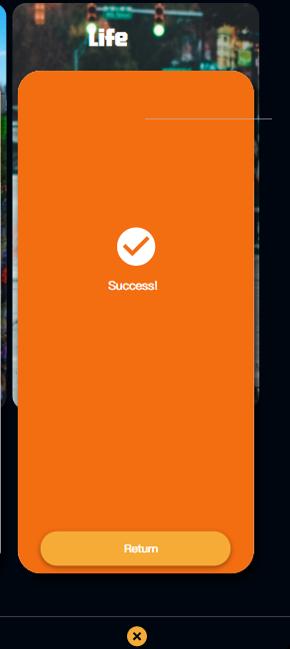
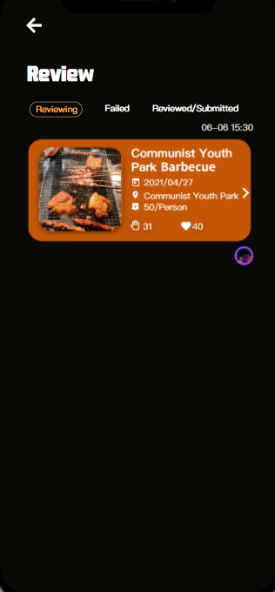
UI-Design
Permit easy reversal of actions in order to relieve anxiety and encourage exploration, since the user knows that he can always return to the previous state.
---Shneiderman's eight golden rules

Slide 17
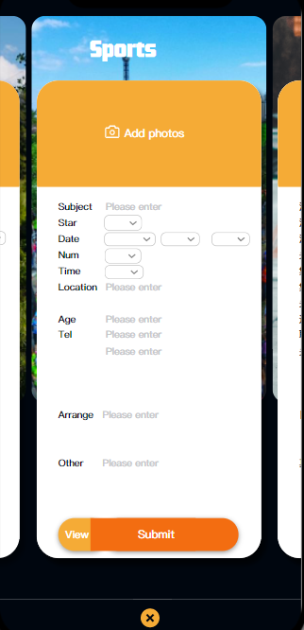
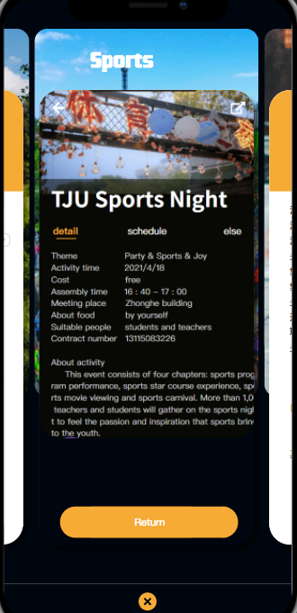
UI-Design
As much as possible, design the interface so that users cannot make serious errors;.
---Shneiderman's eight golden rules

Slide 18
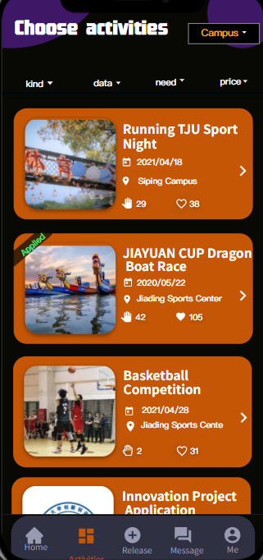
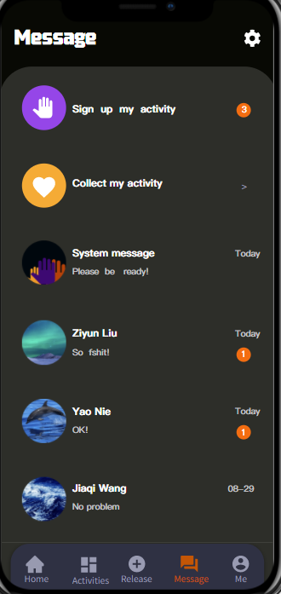
UI-Design
Make things visible.
---Norman’s seven principles
No apply
Applied
Unread

Slide 19
UI CHANGE
AND EVALUATION

Slide 20
UI CHANGE
AND EVALUATION
Based on Task1
---Zhuang Zhenhua

Slide 21
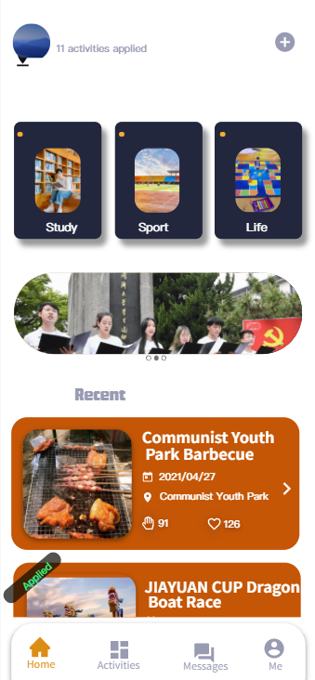
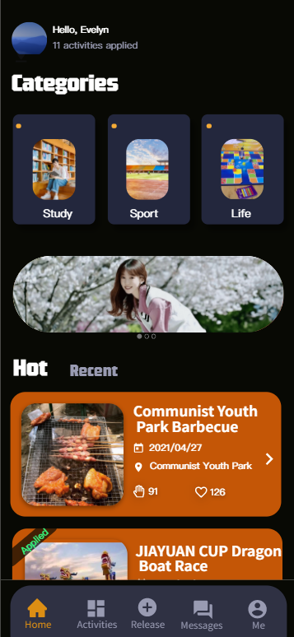
Cognitive walkthroughs
Task 1: Release your first activity
Problem 1
You look for buttons in the bottom menu bar that may contain releasing activities function, but find that only the activity bar looks more likely. After clicking it you discover it is not, so you feel very upset.
It turns out that the releasing activity button is in the upper right corner.
Update 1
Therefore, we adjust the releasing activity button to the middle of the menu bar for easier searching.
Homepage
Homepage

Slide 22
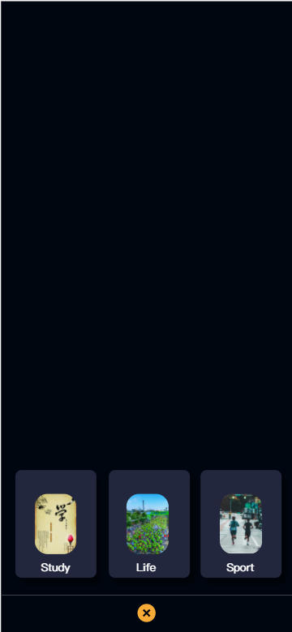
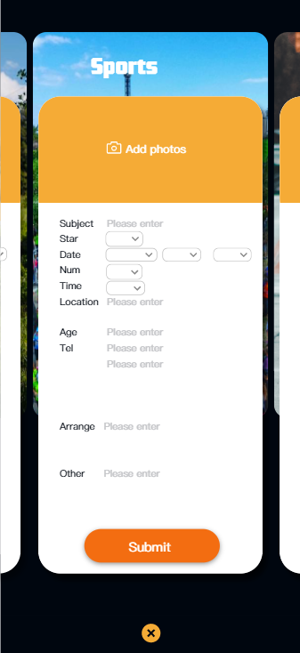
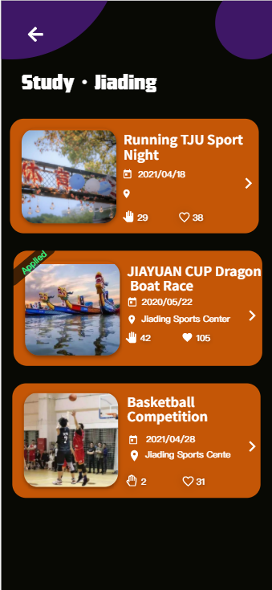

Cognitive walkthroughs
Task 1: Release your first activity
Completed!
?? ？？？???????
Oh no!!!，
I missed its place!!!!！！！
Step 1
Choose category
Step 2
Enter information and submit
view activities

Slide 23
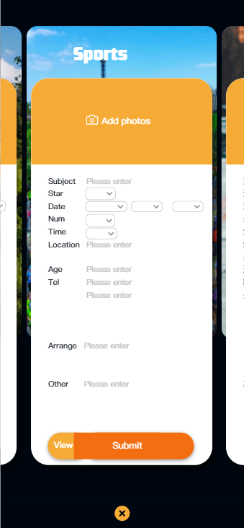
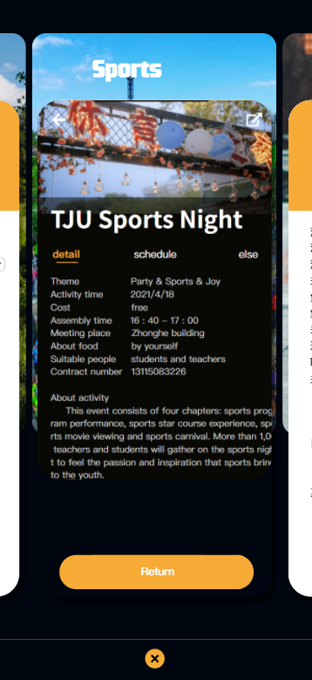
Cognitive walkthroughs
Task 1: Release your first activity
Problem 2
You can’ t view final display in real time when you submit your activity.
Update 2
Therefore, a view button is added next to the submit button, which is convenient for viewing the final state after submitting and for timely modification.
Before change
After change

Slide 24
UI CHANGE
AND EVALUATION
Based on Task2
----Nie Yao

Slide 25
Experimental evaluation
^^
PARTICIPANTS
The Choice of Participants
Participants should be chosen to match the expected user population as closely as possible. Because the target users of our product are students of Tongji University, we only need to choose from the students around us as participants to achieve this goal perfectly.
The Sample Size of Participants
Usability testing with 1 participant will find about a third of the usability problems, while there is little to be gained from testing with more than 5. If the intention is to run a controlled experiment and perform statistical analysis on results, at least 10 is recommended. Thus we choose 10 as the sample size.
Our Participants
With 5 males and 5 females.
Their age is between 18 ~ ~22 years old.
They are all students of Tongji University.

Slide 26
Experimental evaluation
^^
VARIABLES
Independent Variable
Dependent Variable
Where The Notification Settings Page Is Placed
Time Users Takes To Find Notification Settings
We can manipulate the position of the notification page to produce different conditions for comparison, so it is a independent variable.
One of levels of this IV is that the notification settings page is placed on the message page, and another is that it is placed in the Me->>Settings->Notifications together with other settings.
Time taken by users to find notification settings, which depends on the changes of IV, can be measured in the experiment, so it is a dependent variable.
When the depth increases, users need to click more button and view more page, which may influence the time.

Slide 27
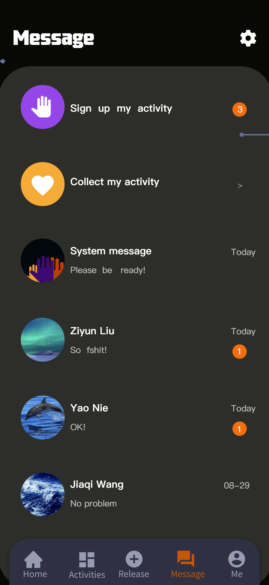
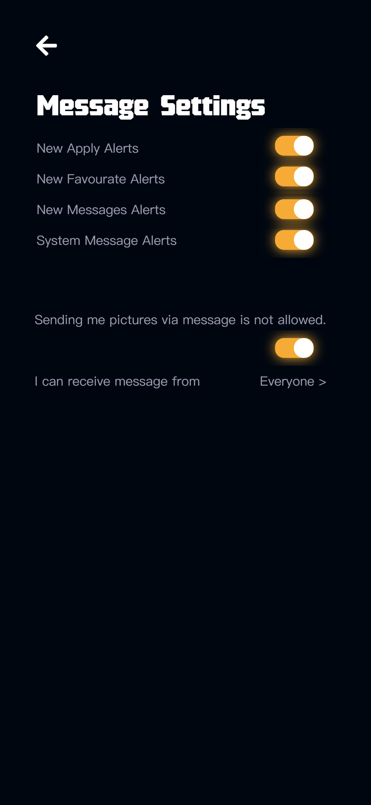
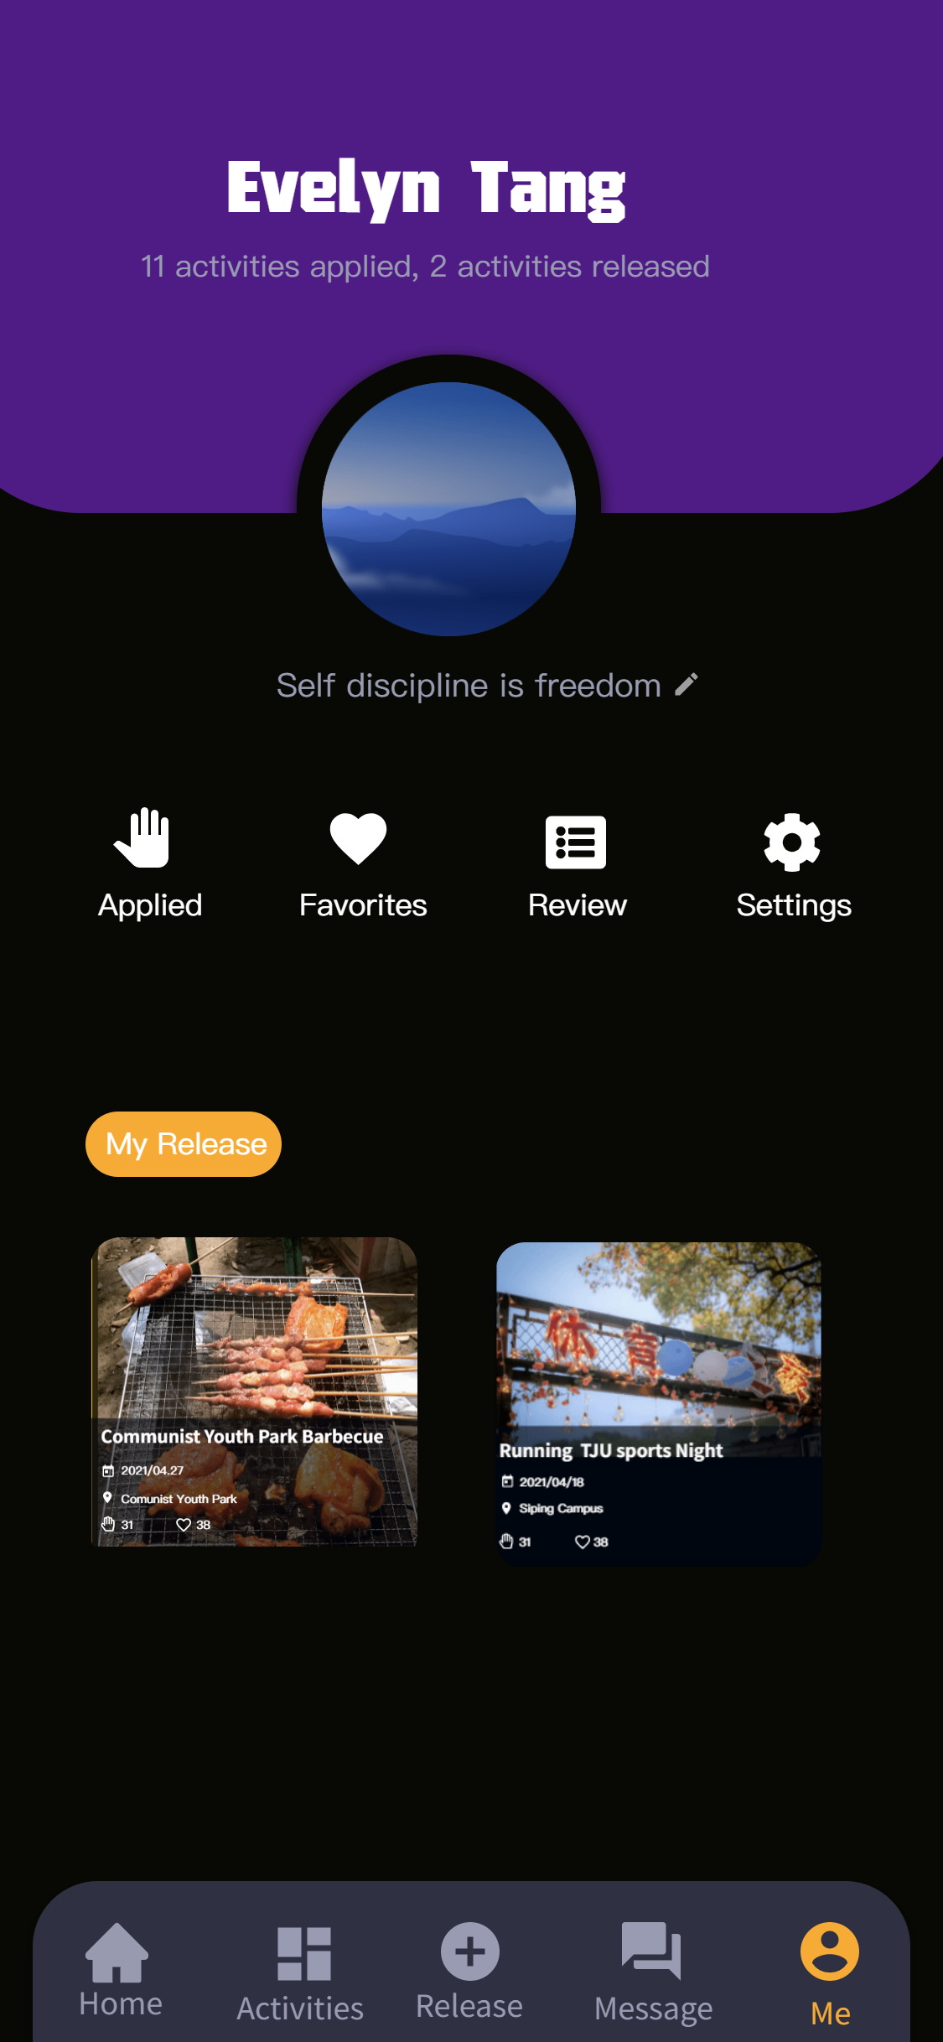
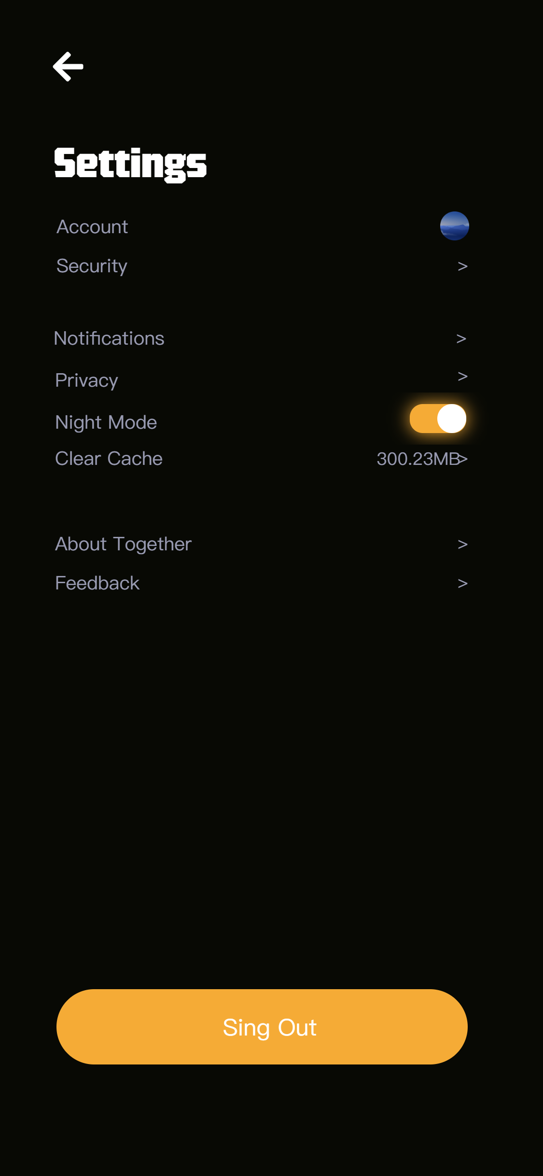
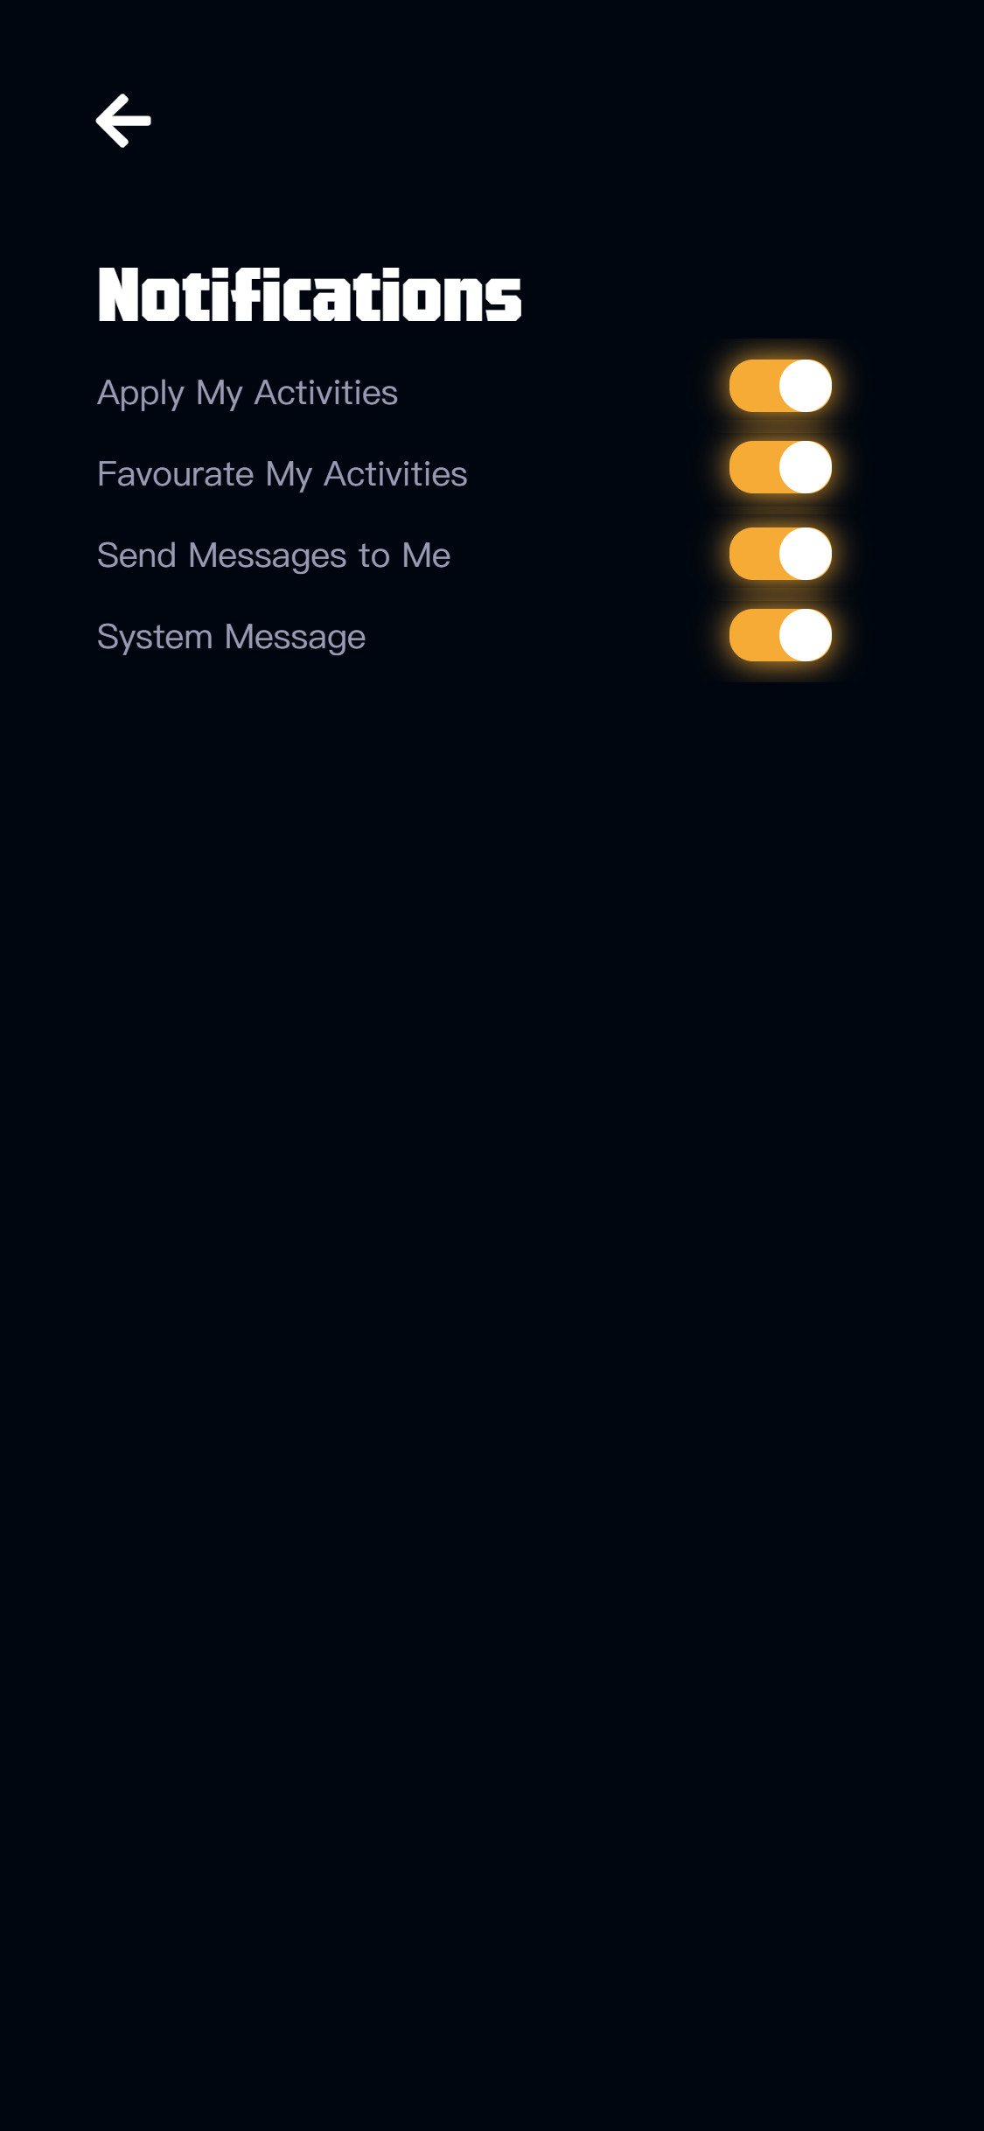
Experimental evaluation
^^
CONDITION
Experimental Condition:: - System 1
Control Condition - System 2
B U S I N E S S
$79/MO
A company is an association or collection of individuals, whether natural persons, legal persons, or

Slide 28
Experimental evaluation
^^
HYPOTHESE
Hypothesis
Null Hypothesis
With the decrease of the depth of page level, time taken by users to find the notification setting page will decrease.
System 1 takes less time.
No change happens with the decrease of the depth
of page level.
System 1 and 2 take the same time.

Slide 29
Experimental evaluation
^^
EXPERIMENTAL DESIGN
Experimental Method
We use the within-subjects method.
Group Division
The participants are divided into 2 groups. Each group has 6 people, performing under each different condition.
Experimental Procedure
All of them need to find notification settings page with the main page as the starting point.

Slide 30
Experimental evaluation
^^
STATISTICAL DATA
Group | Group A |  |  |  |  | Group B
Participant ID | 01 | 02 | 03 | 04 | 05 | 06 | 07 | 08 | 09 | 10 | Sum | Avg
System 1/s | 3.82 | 3.53 | 3.78 | 3.22 | 3.51 | 4.72 | 2.82 | 3.92 | 3.62 | 2.27 | 35.21 | 3.52
System 2/s | 8.73 | 6.36 | 5.40 | 8.75 | 9.60 | 10.28 | 9.64 | 5.24 | 7.31 | 9.55 | 79.86 | 7.99

Slide 31
Experimental evaluation
^^
CONCLUSION
Experimental Condition
User take less time under experimental condition, which means that system with experimental condition is more friendly to users.
Control Condition
But from the perspective of system integrity, all setting options need to be arranged together.
Final Decision
We finally decided to keep these two pages, which not only guarantees the integrity of the system, but also makes it easy for users to immediately enter the notification setting page when they see the message.

Slide 32
UI CHANGE
AND EVALUATION
Based on Task3
----Sun Shichen

Slide 33
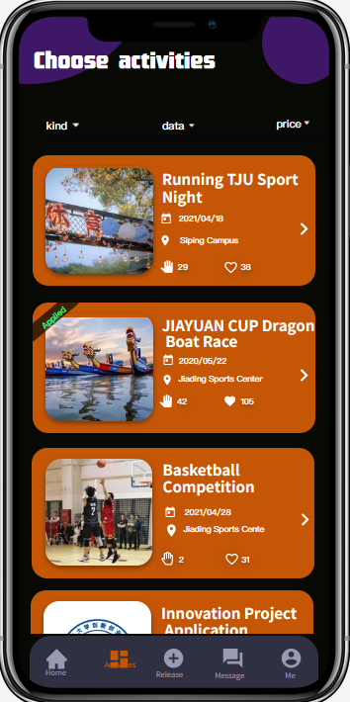
Query techniques^^ &
Experimental evaluation
Task 3: Find what you are looking forward
Description:
:: There are many activities waiting for our participation. We need to filter to find suitable activities.

Slide 34
Query techniques^^
We send out questionnaires to let others comment if there is any shortcomings. A total of 22 questionnaires were received, and the following feedback was obtained.
We found that many people needs the increase of remaining number of people and increase campus.
Summary and reflection

Slide 35
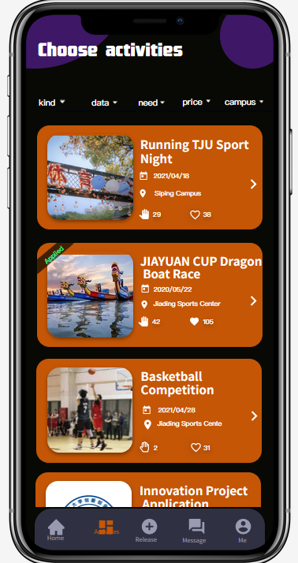
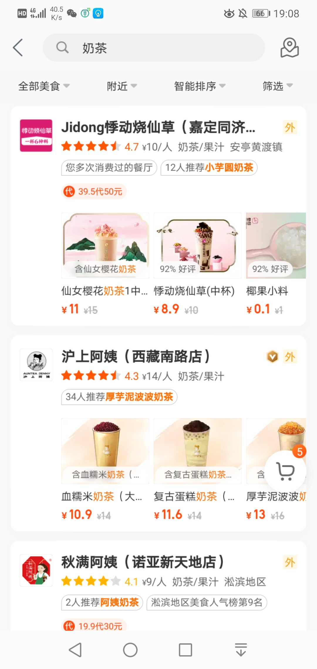
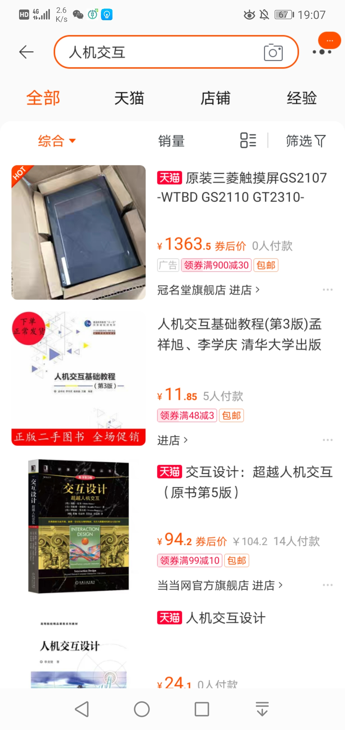

Slide 36
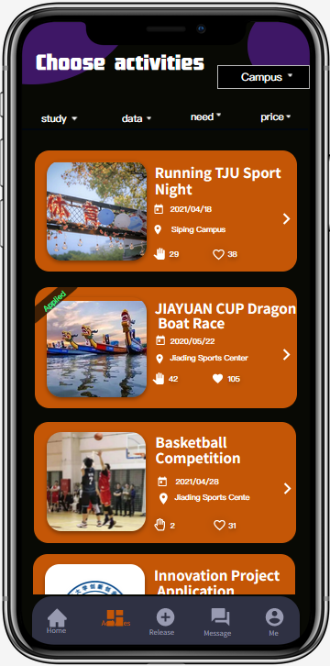
Experimental evaluation
^^
OR??

Slide 37
Experimental evaluation
^^
ID/ | 5 /sec | 4+1 /sec | 5/ Error times | 4+1 / Error times
1 | 4.1 | 2.9 | 2 | 0
2 | 4.8 | 3.1 | 3 | 1
3 | 4.6 | 2.7 | 3 | 0
4 | 4.5 | 4.5 | 3 | 2
5 | 5.1 | 2.9 | 4 | 0
6 | 4.5 | 3.2 | 2 | 1
7 | 4.9 | 3.1 | 3 | 0
8 | 5.3 | 3.0 | 4 | 0
9 | 4.6 | 2.8 | 3 | 0
10 | 5.0 | 3.2 | 4 | 1
total | 4.74 | 3.14 | 3.1 | 0.5

Slide 38
Experimental evaluation
^^

Slide 39
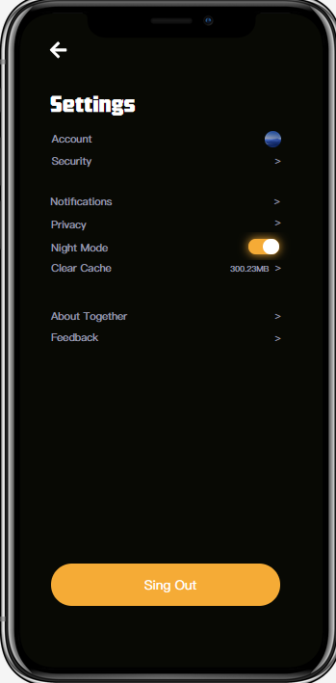
Heuristic evaluation
^^
Theory 3:
User control and freedom
an obvious exit in the interface
put the back button in the upper right corner.
People use apps every day, and many of them have formed guidelines. We use this design to allow users to get started more quickly. [1]
LEARN MORE

Slide 40
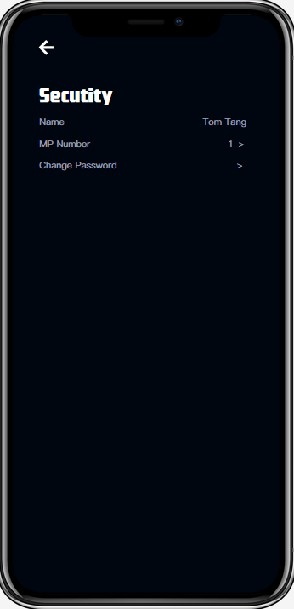
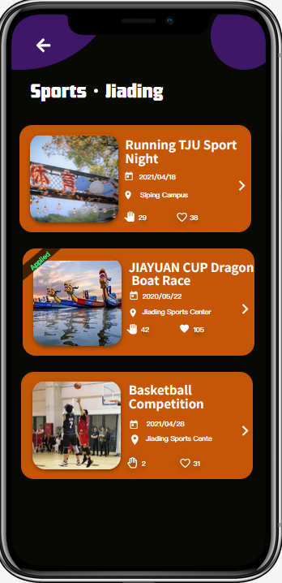
Heuristic evaluation
^^
Theory 6:
Recognition rather than recall
We try to mark the function of the page on each page, so that users know which page they are on, instead of remembering what they just clicked

Slide 41
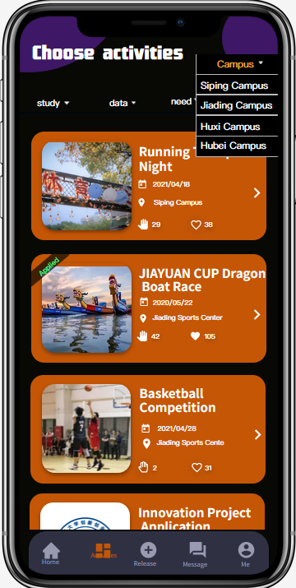
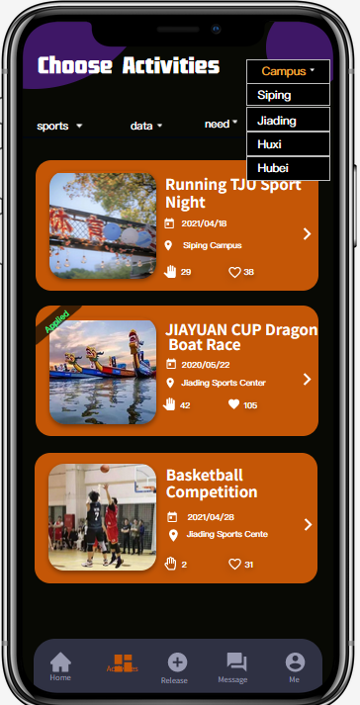
Heuristic evaluation
^^
Theory 8:
Aesthetic and minimalist design
Considering that this APP is for students of Tongji. We know that it is the Siping Campus when we see siping, so we can delete the campus in the option to make it clear.

Slide 42
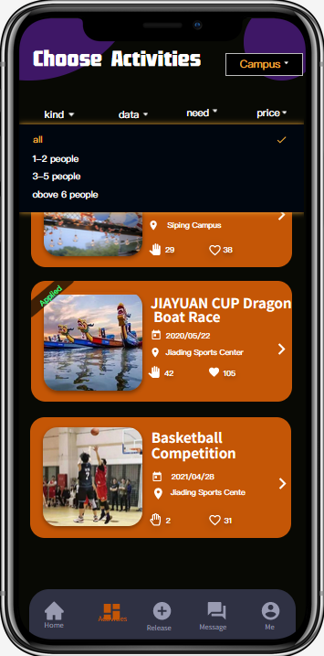
Heuristic evaluation
^^
Theory 4:
Consistency and standards
We found a shortcoming of the system through the method of Heuristic evaluation. But we didn't find a suitable word to replace the remaining people, and the whole writing process was too long, so we chose ‘need’ temporarily.

Slide 43
Evaluation we use
Cognitive walkthrough
Query techniques
experimental evaluation
heuristic evaluation
Most useful in helping us correct problems
Most useful in helping us find the problem

Slide 44
Why Heuristic evaluation is usability? ?
Evaluate the entire system at the same time
Use less people
Give reference direction
Why experimental evaluation is usability?? ? ?
The result is more objective and meaningful

Slide 45
FINAL INTERFACE
----Zhuang Zhenhua

Slide 46






Final interface
^^
Part 1: the functionality
main
activities
login
login
main
activity
chats
release
user
release
chats
user

Slide 47

Final interface
^^
Part2 the user interface design

Slide 48


Final interface
^^
Part 3 the most difficult part
Part 4 how to make it work
The most difficult is not which part, but every detail.
Install our final apk file on your Android phone, so you can run it.
We use the animation effect to make the entire interface more friendly.
This kind of detail is what we think the most difficult.

Slide 49
REFERENCE

Slide 50
Reference
^^
[1] Ling ma. User interface design analysis based on interactive experience and visual experience[J]. industrial design, 2021(03) : 80 - 81.

Slide 51
THANK FOR LISTENING

